Slide 1
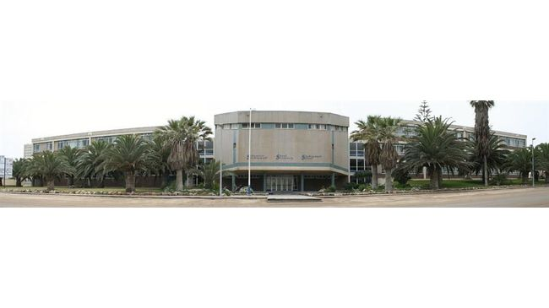
SWAKOPMUND SECONDARY SCHOOL
GRADE 8 COMPUTER STUDIES NOTES
TOPIC: CLASSIFICATION OF VARIOUS TYPES OF COMPUTERS
Mr Kanhalelo

Slide 2
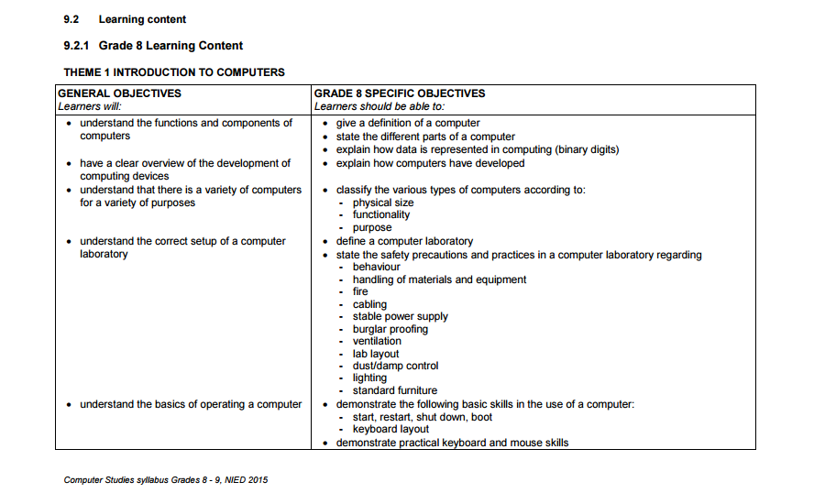

Slide 3
Classify the various types of computers
We see many Computers nearby, But they all are different from each other.
There are different classes of computer technology available these days.
The functionality and data processing of each type of computer is different.
Computers are mainly classified according to Physical Size, functionality and purpose.
Computers are typically classified into seven categories namely;
Personal Computers
Mobile Computers
Game Consoles
Servers
Mainframes
Supercomputer
Embedded Systems

Slide 4
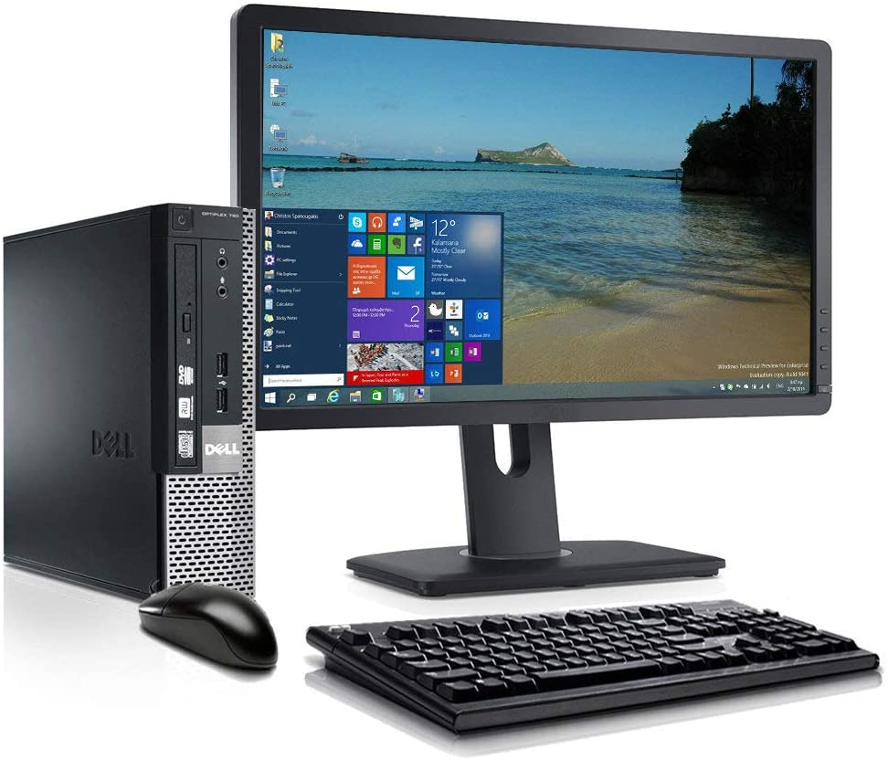
Personal Computers
A personal computer is a computer which can perform all of its input, processing, output and storage activities by itself.
Different types of personal computers
Desktop Computers
Physical Size: Designed so that the hardware components
Can fit entirely on a desk.
Function: multimedia entertainment, playing PC games, accessing the Internet.
Purpose: It designed to be used by a single end-user.

Slide 5
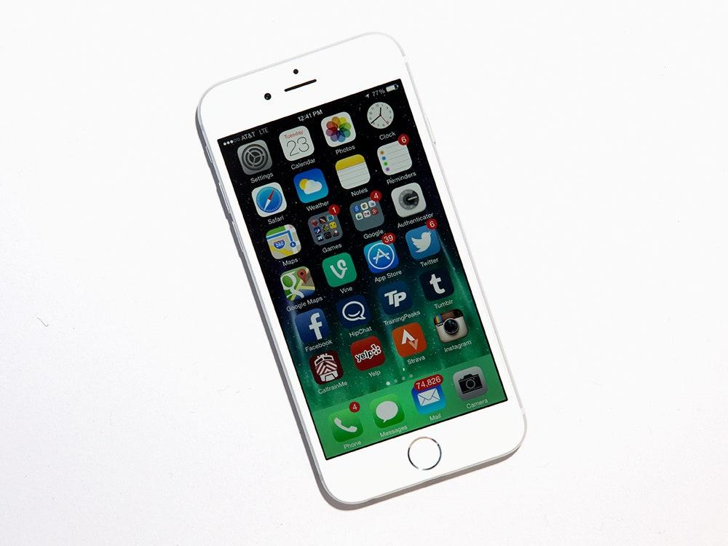
Mobile Computers/Devices
This are Small portable digital mechanisms such as phones or tablets that provide access to the web, apps, and other software.
Physical Size: Small Enough to hold in a hand
Function: to run mobile apps, capture barcodes, take photos and videos, and provide voice and data communications
Purpose: It designed to be used by a single end-user

Slide 6
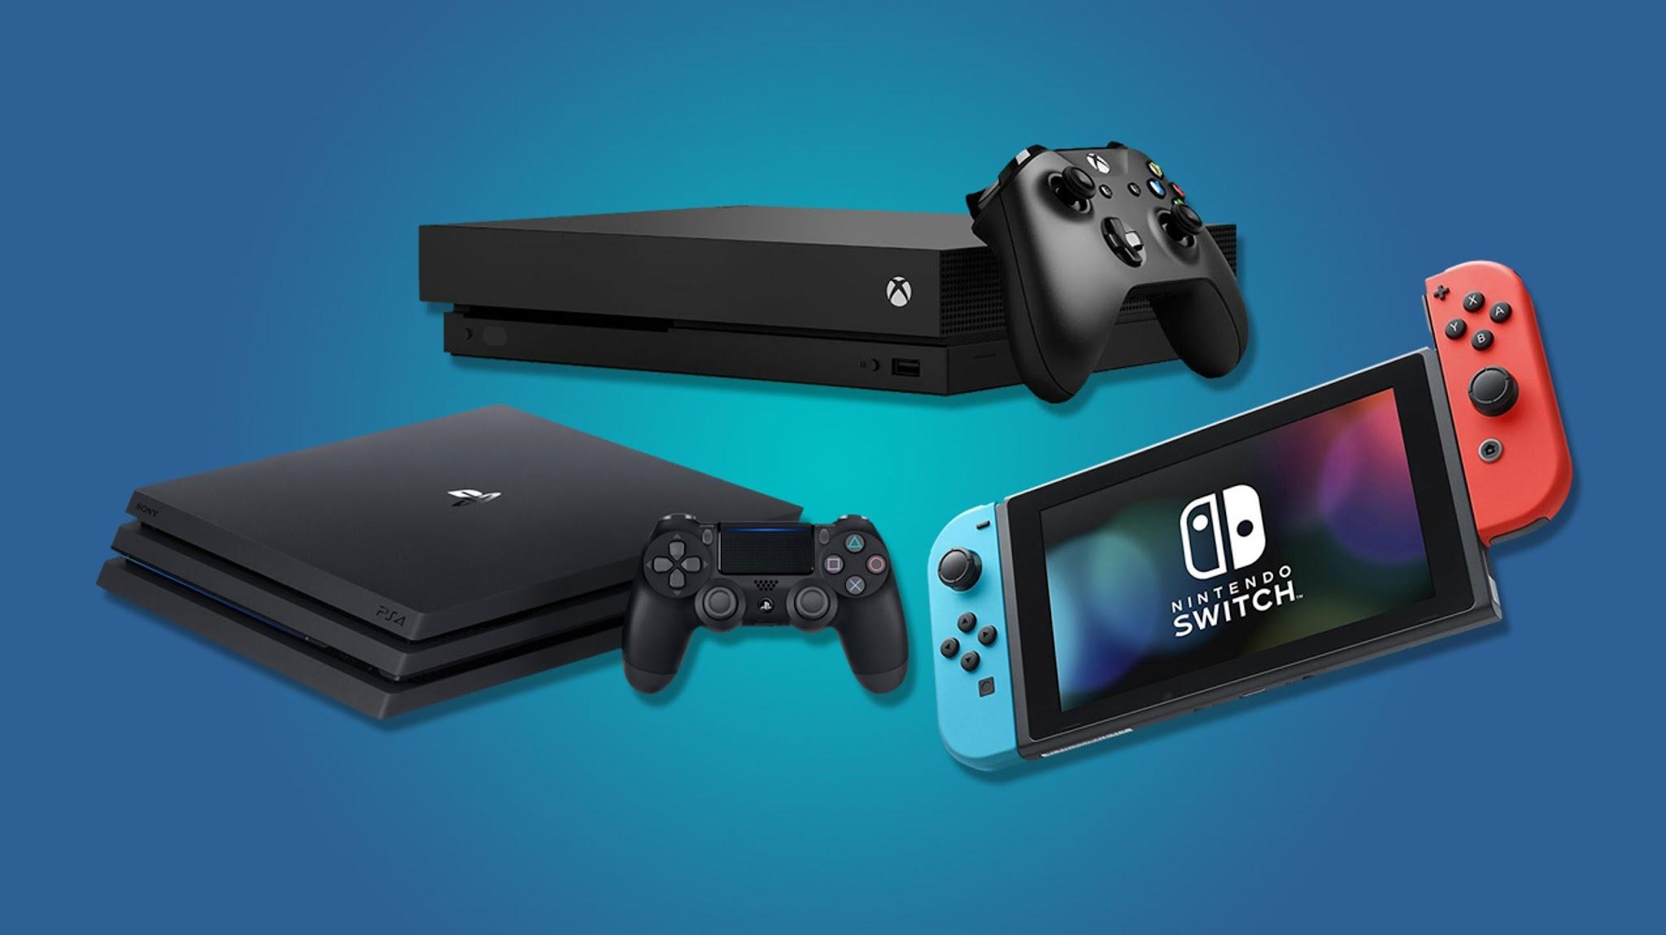
Game consoles
Is a specialized mobile computing device used to play single player or multiplayer video games.
Most popular models are;
Microsoft Xbox
Sony PlayStation
Nintendo Switch
Physical Size: Designed so that the hardware components
Can fit entirely on a desk
Function: multimedia entertainment, playing PC games, accessing the Internet
Purpose: It designed to play video games

Slide 7
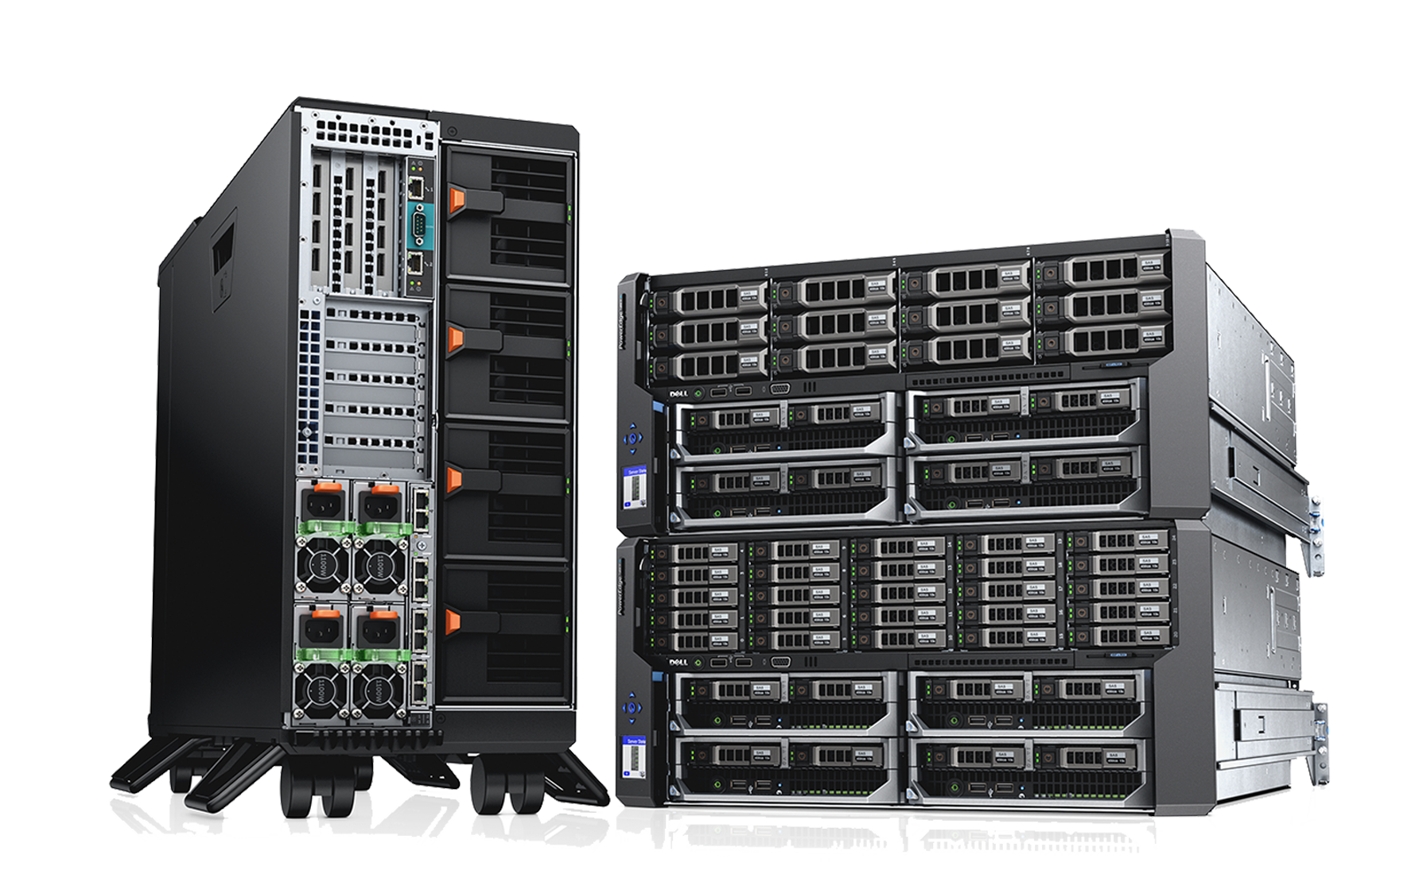
Server
Is a specialized mobile computing device used to play single player or multiplayer video games.
Physical Size: A typical server can be 1, 2, 3, or 4 rack units tall.
Function: Control access to the hardware, software and other resources on a network.
Purpose: To Provide information or services to the other computers.

Slide 8
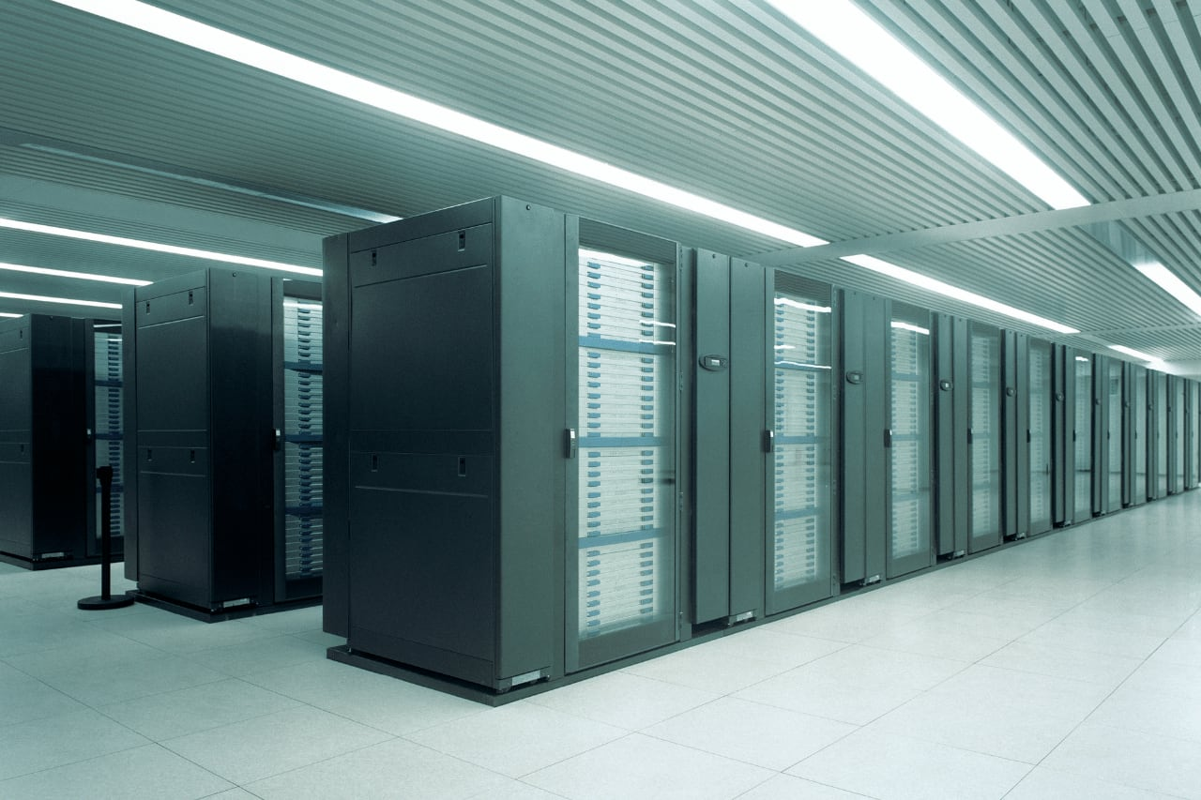
Mainframes
This are very large, expensive, powerful computers that can handle hundreds or thousands of connected users at the same time.
Physical Size: Very large computers
Function: Used by large companies to bill millions of customers and manage thousands of items in inventory.
Purpose: Designed to store large amounts of data, instructions and information.

Slide 9
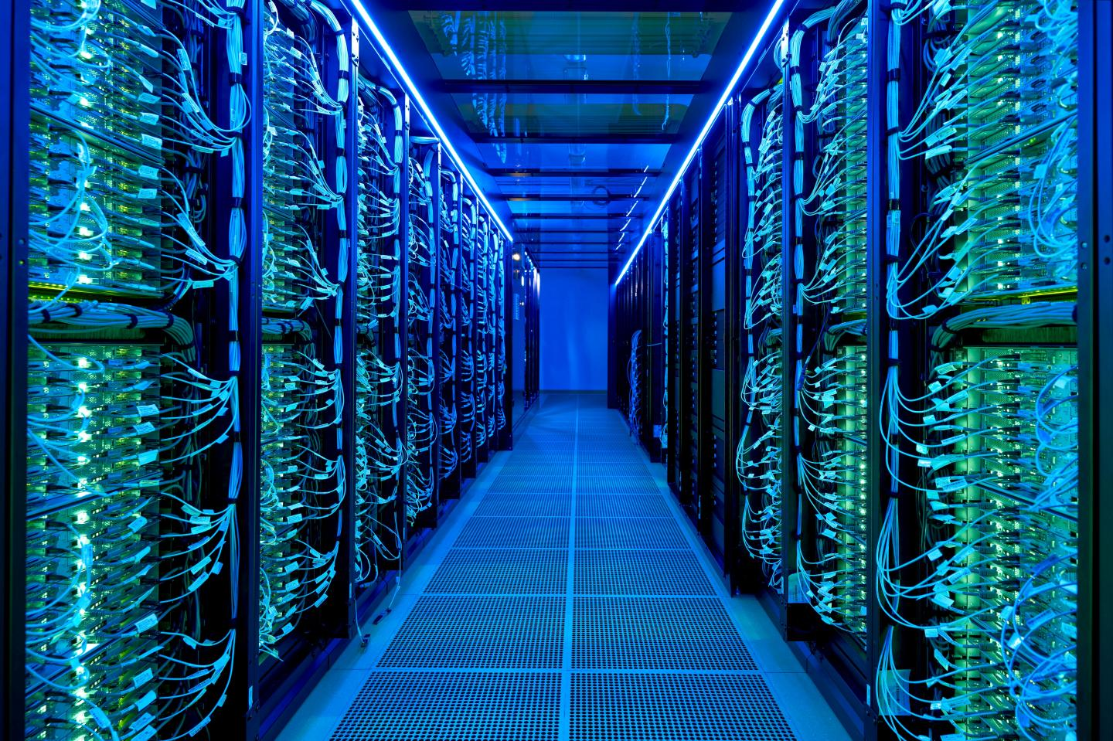
Supercomputers
A supercomputer is a computer with a high level of performance compared to a general-purpose computer..
Physical Size: Their weight exceeds 100 tons ~ 9000 kg
Function: Used in climate research and Weather Forecasting and Prediction of Natural Disasters
Purpose: Designed to process vast amounts of data in a short time with high productivity.

Slide 10
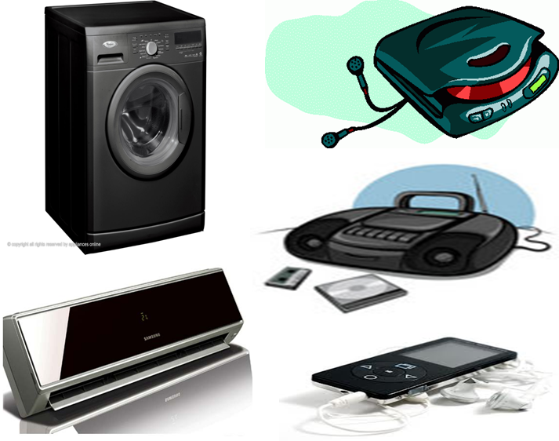
Embedded Systems
Embedded means - Hidden inside so one cannot see it.
System means - Multiple components interfaced together for a common purpose
Physical Size: They differ in sizes and functionality.
Function: Used to control, monitor, or assist the operation of equipment, machinery, or plant.
Purpose: To control a specific function within a device.

Slide 11
THANK YOU

